Slide 1
Vaccine for Child
Database System Project

Slide 2
Project Information
Github: https://github.com/dipu-bd/VaccineForChild
FrontEnd: Bootstrap, AngularJS
BackEnd: NodeJS
Database: MySQL
Database Design: https://editor.ponyorm.com/user/sdipu/VaccineDB

Slide 3
Developer Information
Team Name: DBLab
Team Members:
Sudipto Chandra Das Reg No: 2012331019 dipu.sudipta@gmail.com
Bishwajit Purkyastha Reg No: 2012331013 bishwa420@gmail.com
Supervisor
Mr. Biswapriyo Chakrabarty Lecturer, Department of Computer Science and Engineering, Shahjalal University of Science and Technology.

Slide 4
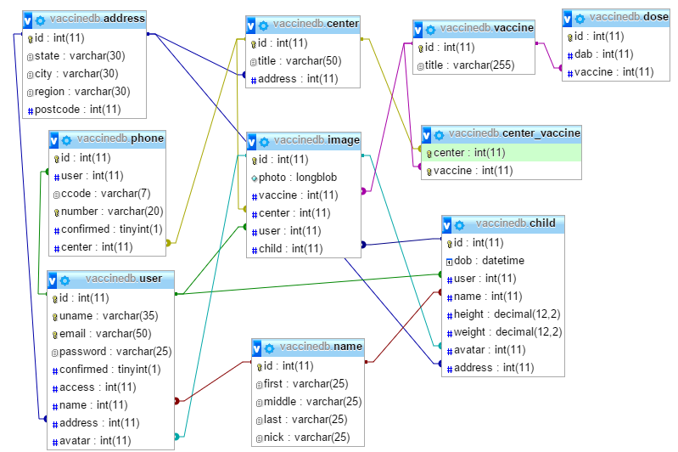
E-R Diagram of Database

Slide 5
Main Page (Not Logged In)
Top Navigation Bar
Register
Login
Carousal
Bottom Bar : For links and other site info

Slide 6
Main Page (Carousal)

Slide 7
Main Page (General User)
Sidebar
Navigation Bar
User
Children
Vaccines
Centers
Options
Logout
Home Page
Overview of Children
Upcoming Schedules
Child Overview Box
First Child
Child Overview Box
Second Child
Recent Events
Child Overview Box
Third Child

Slide 8


Sidebar: Children
List of Children
Child Information (Editable)
First Child
Child ID
Child Name
Child Age
Date Of Birth
Male/Female
Height – Weight
Vaccines Given
Vaccines Pending
Second Child
Third Child

Slide 9
Sidebar: Vaccines
List of Vaccines
Vaccine Overview
What for
Short Description
Time of apply
Repetition Periods
Vaccine Overview
What for
Short Description
Time of apply
Repetition Periods
Vaccine Overview
What for
Short Description
Time of apply
Repetition Periods

Slide 10
Sidebar: Vaccination Centers

